Slide 1
ARC FY2022 Grant Nuts & Bolts
Brought to you by Southern Tier West
Dr. Fileve Tlaloc Palmer

Slide 2
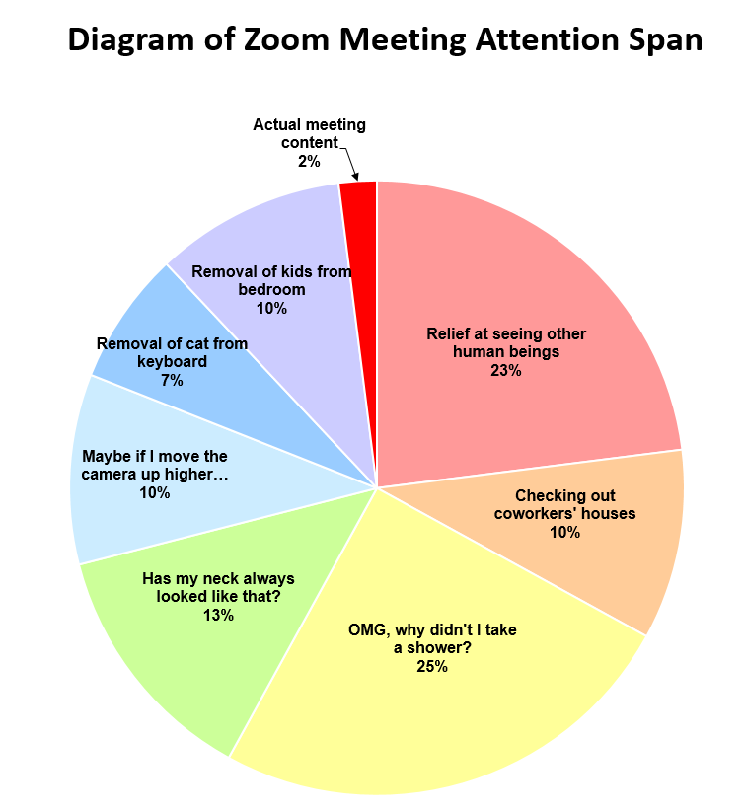
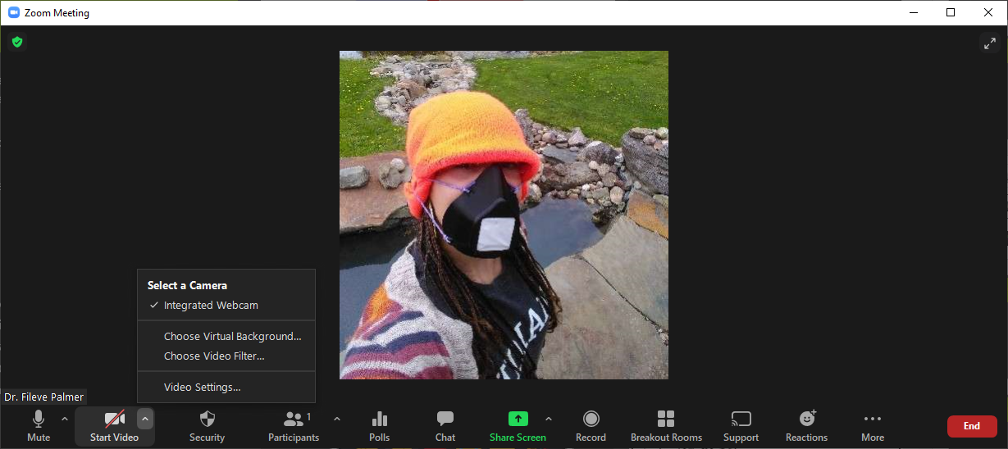
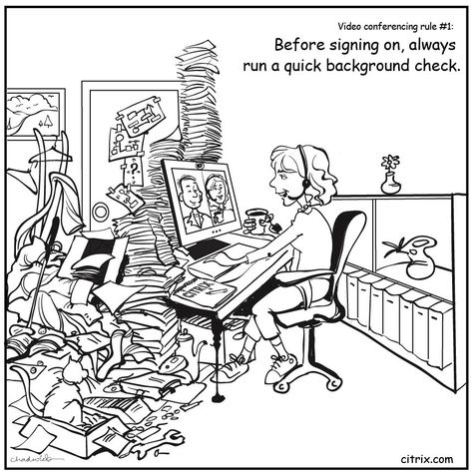
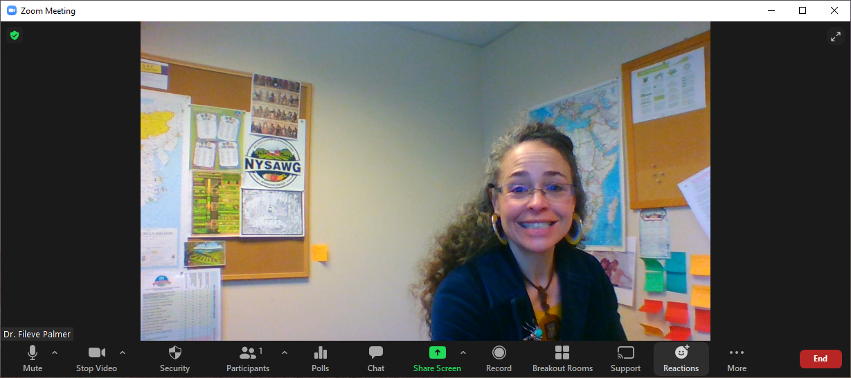
Welcome!!!!!!
Best Practices
Audio: Please remember to mute
Camera on or off?
Use your body
Use emojis
Use the chat box!
Agenda:
Calendar
LOI
Eligibility and past funded projects
Maps and Match
Funding priorities:
ARC Goals and NYS Strategy
Outputs & Outcomes
Check list and App Grading
Conclusion
Resources
Notes:
Best Practices
Audio – please mute, unless you have a question or comment.
Camera on or off?
Recent research found that the intense, sustained eye contact and self-awareness that web-based meetings produce increases stress. You may hide your self view.
Another study published by Stanford University mentioned increased stress levels with web-based meetings b/c of sustained eye-contact and the appearance of being close to strangers. You can turn your camera view on or off.
Please use emojis! For things you agree with, if you have questions, or comments
Zoom introductions – use the chat box for introductions and questions
Agenda

Slide 4
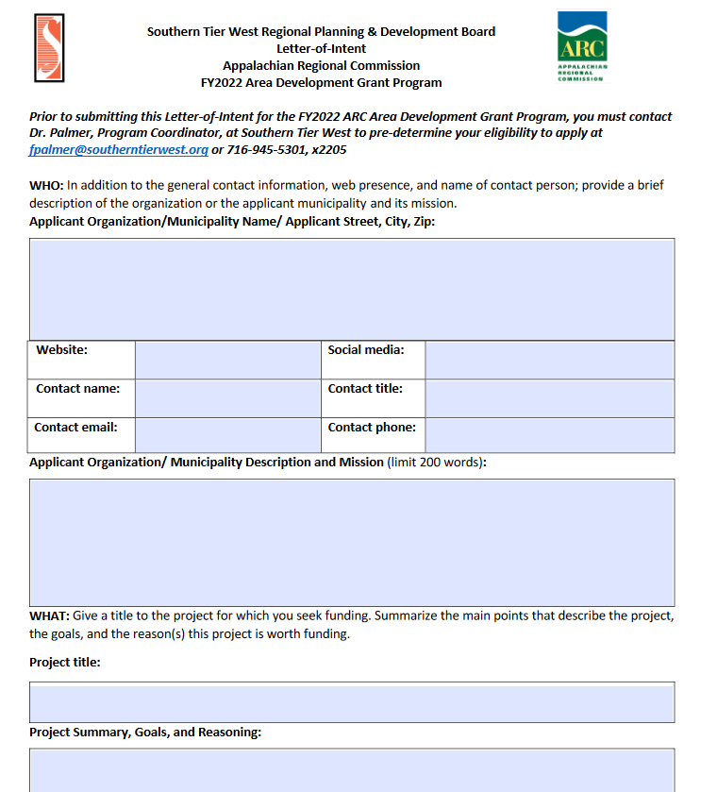
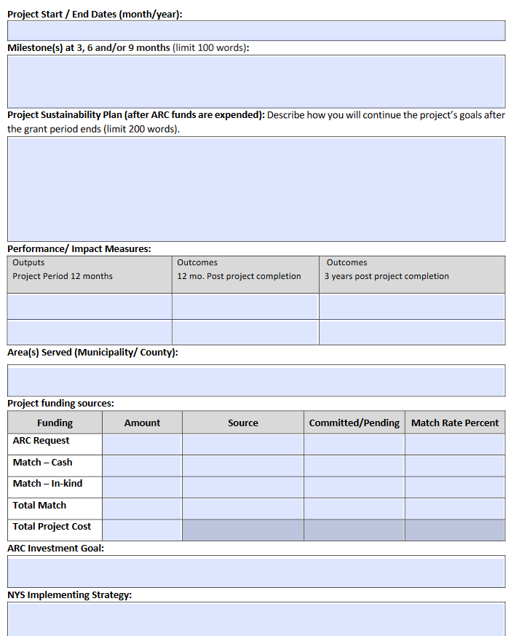
Due April 15

Slide 5
Eligibility
Representatives of businesses or a nonprofit organization that represents businesses, labor organizations State and local governments
Educational institutions
Local, municipal, and county governments
Sovereign Native nations
ARC does not award grants to individuals or for-profit entities.
Notes:
Section 3.2 “ARC grant involving significant construction to be directly administered by the Commission only if the project will be managed by a Federal or State entity experienced in the management of federally funded construction projects.

Slide 7
Appalachia attainment. Competitive, Transitional, At-Risk and Distressed counties!!!!
Notes:
Attainment, Competitive, Transitional, At-Risk and Distressed!!!!

Slide 8
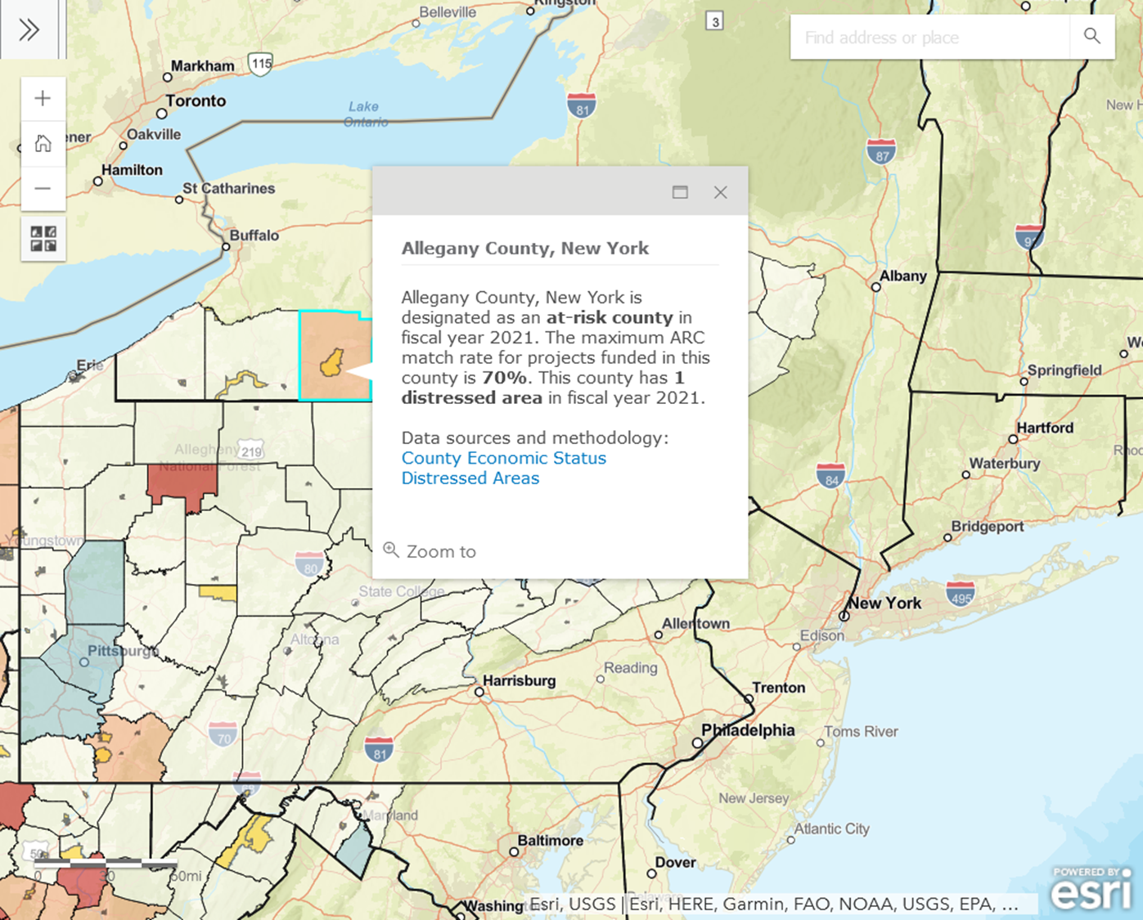
ArDA of 1965 Designations and match
A. Generally, ARC grants are limited to 50% of project costs.
b. Projects in ARC-designated distressed counties, limit can be raised to 80%.
c. Projects in ARC-designated at-risk counties, this limit can be raised to 70%.
d. Projects located in ARC-designated competitive counties (those that are approaching national economic norms), funding is usually limited to 30% of project costs
e. ARC funding is usually not available for projects located in ARC-designated attainment counties (those that have attained or exceeded national economic norms)
Notes:
ARC Project Guidelines p. 4 online at: https://www.arc.gov/wp-content/uploads/2020/08/ARCProjectGuidelines.pdf
Appalachian Regional Development Act

Slide 9
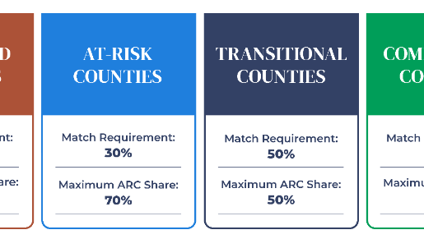
Match for ARC Projects
Cash
Drawn from grantees’ own funds
Cash donations from non-federal third parties e.g., partner organizations
Loans are also counted as cash
In-kind donations
Personnel time given to the project
Person on loan from another organization/corporation
Donation of or use of equipment, like use of a crane or bulldozer
Expert services, like engineering or architectural services
Value of a lease for project space
All applications for ARC funding must include a formal “commitment” letter from the matching source indicating a firm commitment to provide the required match.
Notes:
https://www.arc.gov/wp-content/uploads/2020/09/Match-Requirements-for-ARC-Grants.pdf

Slide 10
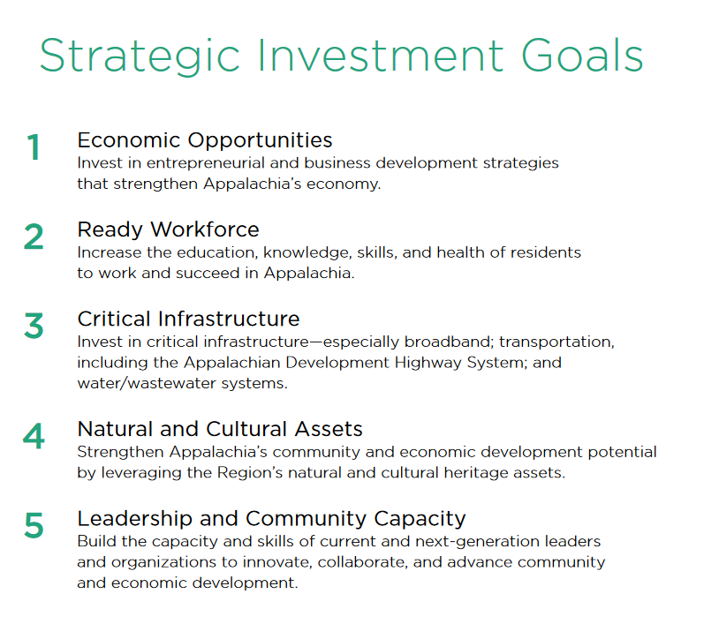
ARC Investment priorities

Slide 11
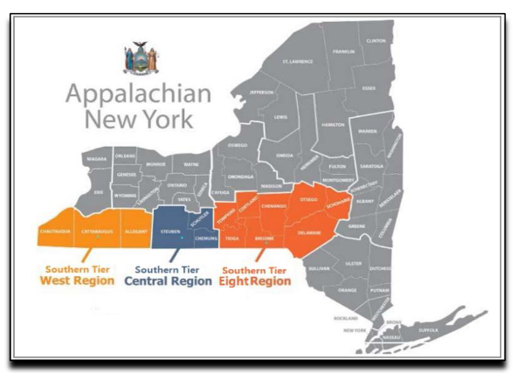
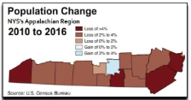
STRATEGY STATEMENT 2020
Section 1.2: Economic Challenges & Opportunities (pp. 3-5)
Downtown Revitalization
Digital Access/Broadband
Labor Force Availability/Needs/Skills
Population Change
Dependent Care
Interruptible Power
Family Agriculture
Opioid Crisis

Slide 12
Section 3: Targeted Investment Priorities (pp. 6)
Pockets of Distress: high rates of poverty, unemployment, and low per capita income.
Economic Clusters, Job Creation and Entrepreneurship

Slide 13
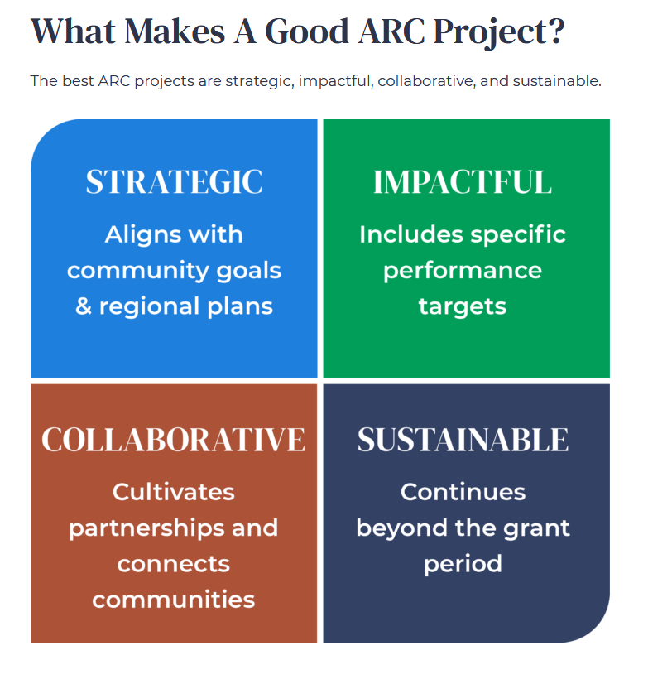
Building success
Solves challenges in new and innovative ways
Includes specific outputs and outcomes
Cultivates new partnerships
Is sustainable beyond the grant period
Notes:
Use the chat box to share your project ideas!! Or if you’d like to share now’s the time.

Slide 14
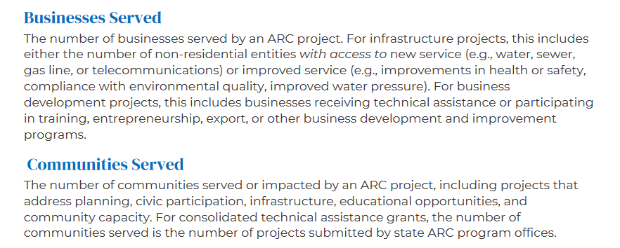
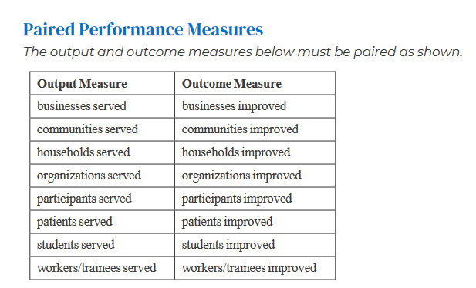
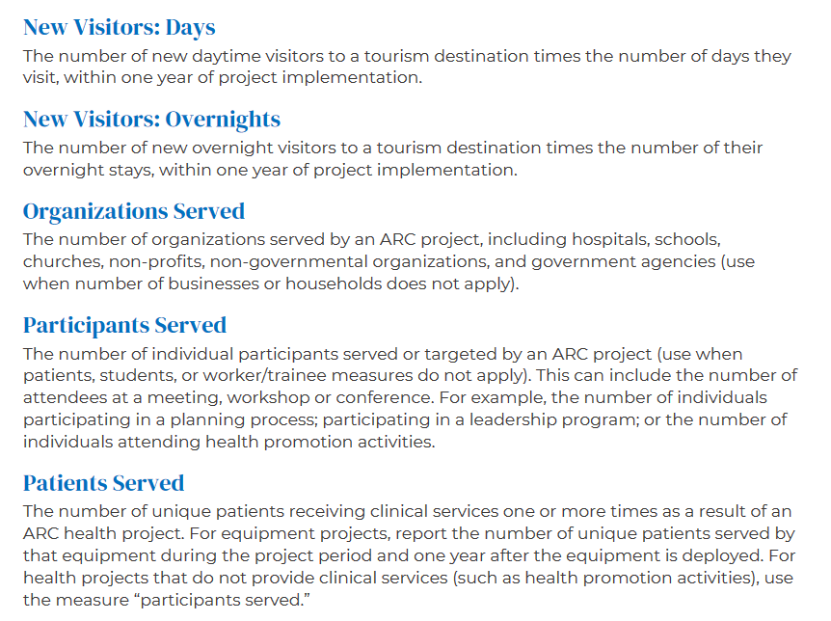
Notes:
https://www.arc.gov/grant-resources/
https://www.arc.gov/wp-content/uploads/2020/08/Guide-to-ARC-Project-Performance-Measures.pdf

Slide 15
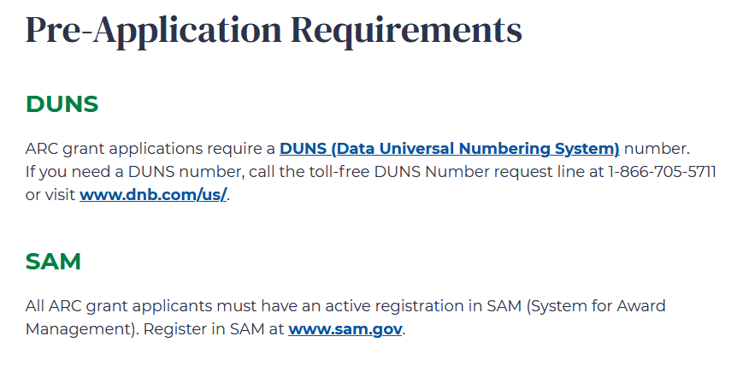

Slide 17
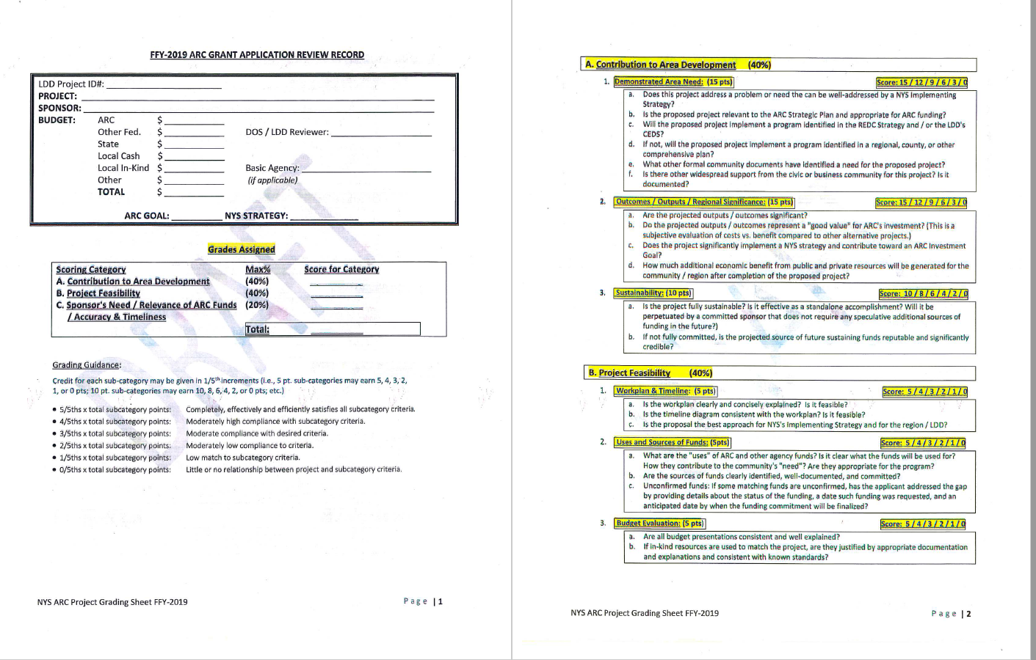

Slide 18
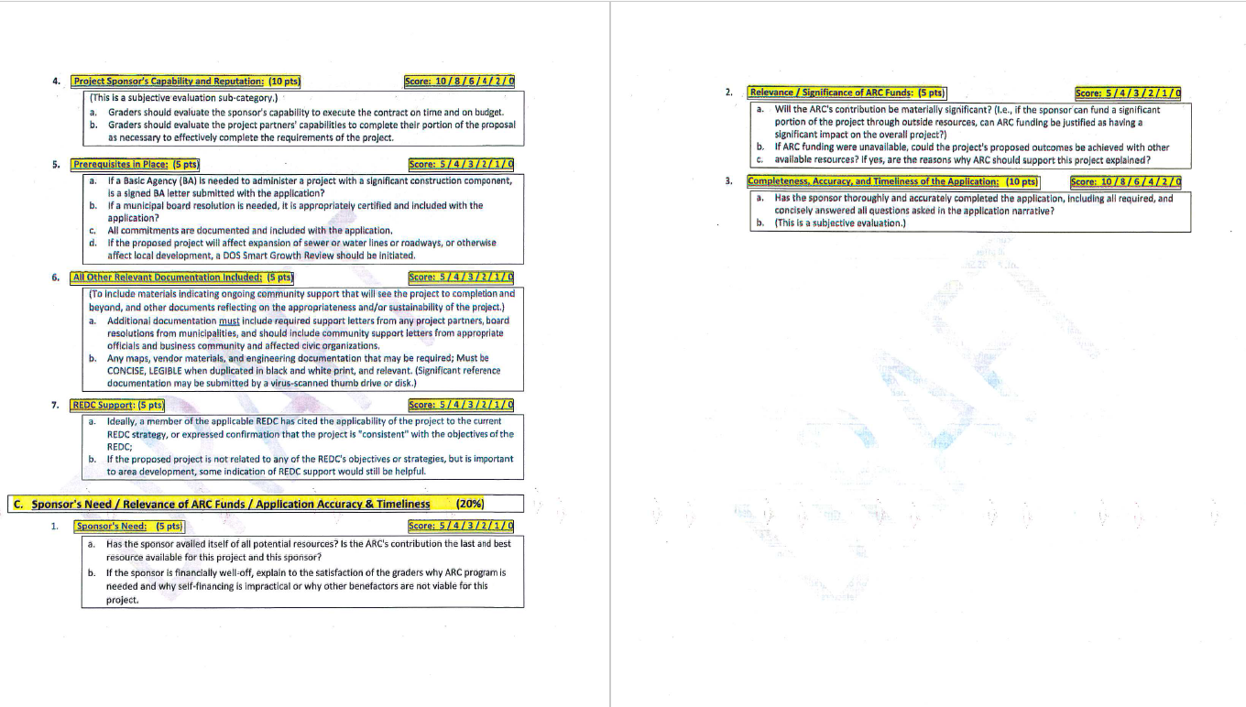

Slide 19
Key Points
Maximum grant $150,000, minimum $10,000
This is a long-haul grant – meaning your project won’t start until mid-2022
Projects can last up to 18 months
Priority given to projects focused on those with significant economic outcomes
Although construction/renovation grants are considered eligible, the extra cost and bureaucracy associated with involving an external government entity to manage the grant AKA “basic agency” is not prioritized.
Planning or RD grants, while eligible, have lower priority than those that are ready to implement plans.
Depending on the ask for any given year between 4-6 projects get funded.
Don’t wait to do your homework and start planning!

Slide 21
Resources
Interactive map online at: https://www.arc.gov/county-economic-status-and-distressed-areas-by-state-fy-2021/
Match Requirements for ARC Grants online at: https://www.arc.gov/wp-content/uploads/2020/09/Match-Requirements-for-ARC-Grants.pdf
NYS STRATEGY STATEMENT 2020 online at: https://www.arc.gov/wp-content/uploads/2020/09/NYS_Appalachian_Region_Strategy_Statement_Fiscal_Year_2020.pdf
ARC Goals: https://www.arc.gov/investment-priorities/
https://www.arc.gov/wp-content/uploads/2016/10/InvestinginAppalachiasFutureARCs2016-2020StrategicPlan.pdf
ARC Project Guidelines: https://www.arc.gov/wp-content/uploads/2020/08/ARCProjectGuidelines.pdf
https://www.arc.gov/wp-content/uploads/2016/10/InvestinginAppalachiasFutureARCs2016-2020StrategicPlan.pdf

Slide 23
Thank you for your time!!!

