Slide 1
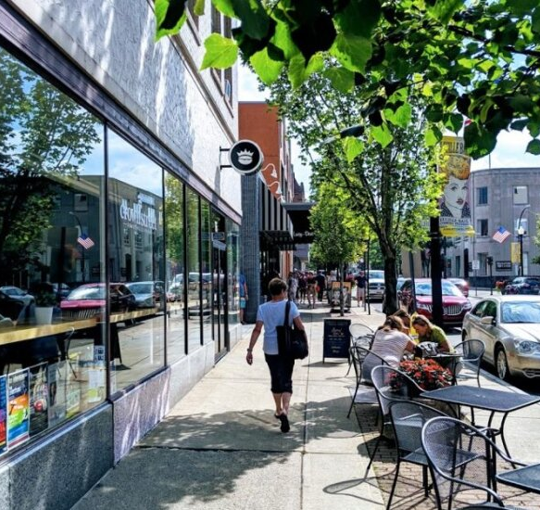





Protecting Community Character Through Zoning Administration and Enforcement
Southern Tier West 2021 Spring Training Workshop
March 10, 2021
Richard Stanton, Esq., Director of Development, City of Lackawanna, NY; Attorney for Village of Ellicottville, NY
Gary Palumbo, Town and Village Planner, Ellicottville, NY

Slide 2


Who We Are
Gary Palumbo, AICP
gary.palumbo@evlengineering.com
716-801-3016
Richard Stanton, Esq.
richard.stanton@yahoo.com
716-827-6421

Slide 3

Who Are You?
Who is participating today?
  Planning Board members
  Zoning Board of Appeals members
  Municipal Board Members
  Planning Consultants
Does your community have the following:
  Architectural Design Standards?
  Difficulty enforcing your Sign Regulations?
  Interest from solar farm developers?
What are your Hot-topic zoning challenges?

Slide 4

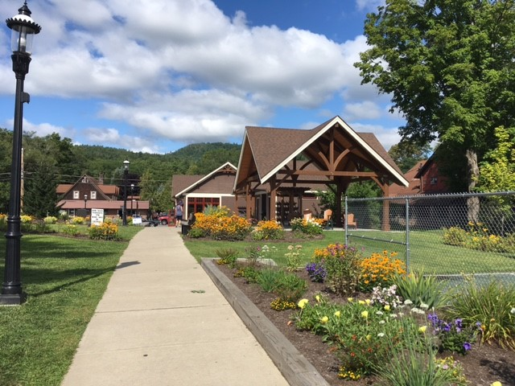
Presentation Overview
Protecting Community Character Through Zoning
Comprehensive Plan
Zoning
SEQR
Enforcement
Case Study
Q&A – through Zoom Chat function

Slide 5
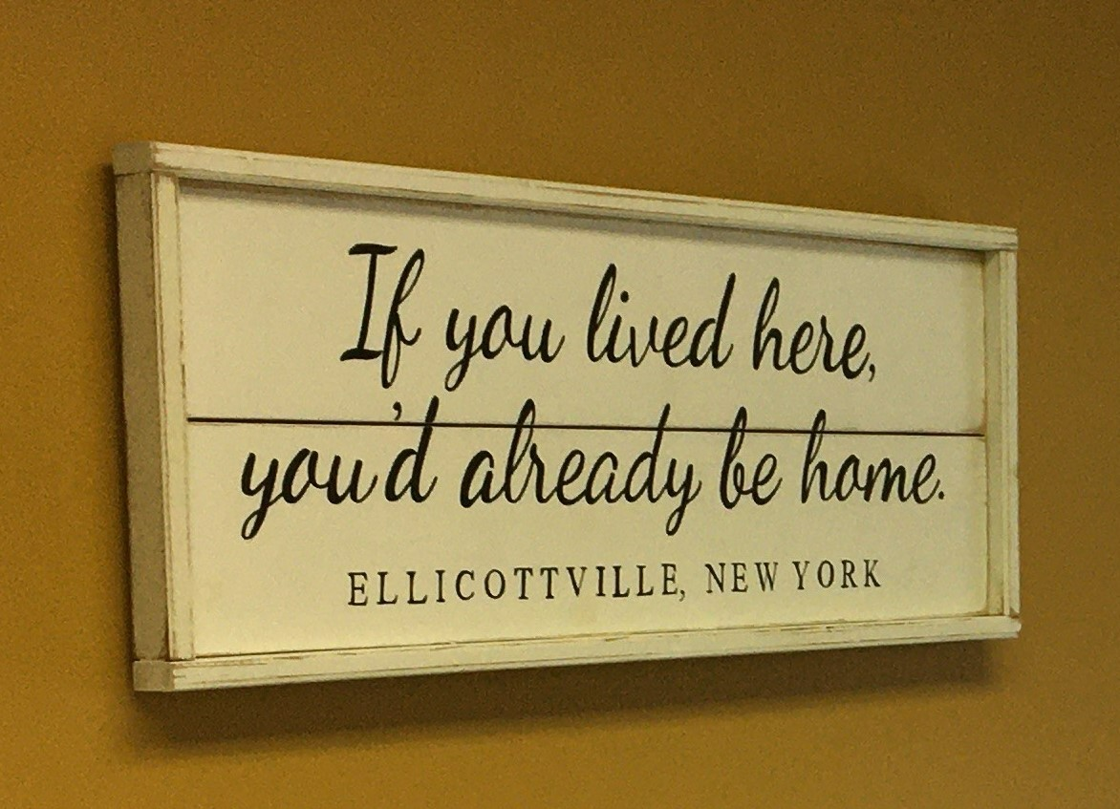
Presentation Goal
GOAL: Provide guidance on how to use comprehensive planning and zoning to protect community character.
Objectives:
To identify and define community character through your plan.
To develop zoning standards.
To putting zoning into practice.
To enforce zoning standards.

Slide 6

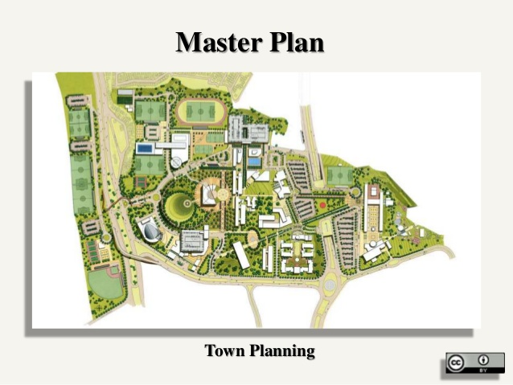
Guiding Community Character
Comprehensive Plan - Zoning
NY State Authorization for zoning is based on: “…in accord with well considered plan”¹ or “…in accordance with a comprehensive plan”²
Drafting Amendments / Special Study
  Define existing character
  Analysis, S.W.O.T.
  Future Vision for your town
  Maps and Graphics
  Recommendations for Zoning Amendments to Facilitate Future Vision
Comprehensive Plan
¹ General City Law §20(25)
² Town Law §263; Village Law §7-704

Slide 7
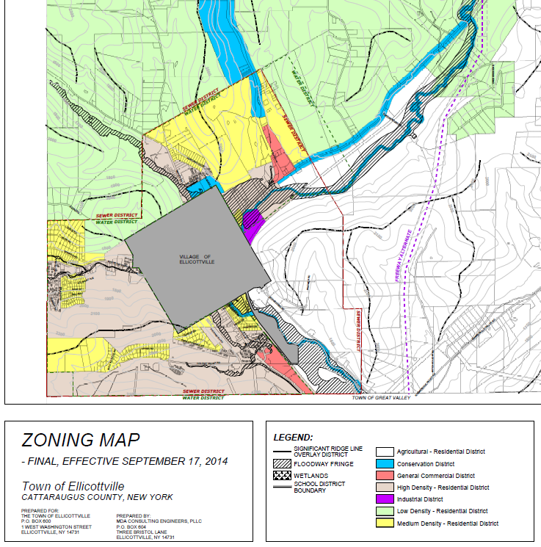

Guiding Community Character
Zoning: Drafting Regulations
Districting
  Purpose and Intent of each District
  Zoning Map
Land Use Tables - What’s Permitted Where
  Categories
    Residential
    Commercial
    Agriculture / Agri. Business
    Mixed-Use
  Assign Uses to Districts
  Assign Jurisdiction:
    As of Right
    Permitted - Site Plan
    Special Use Permit
    Not Permitted
Zoning

Slide 8
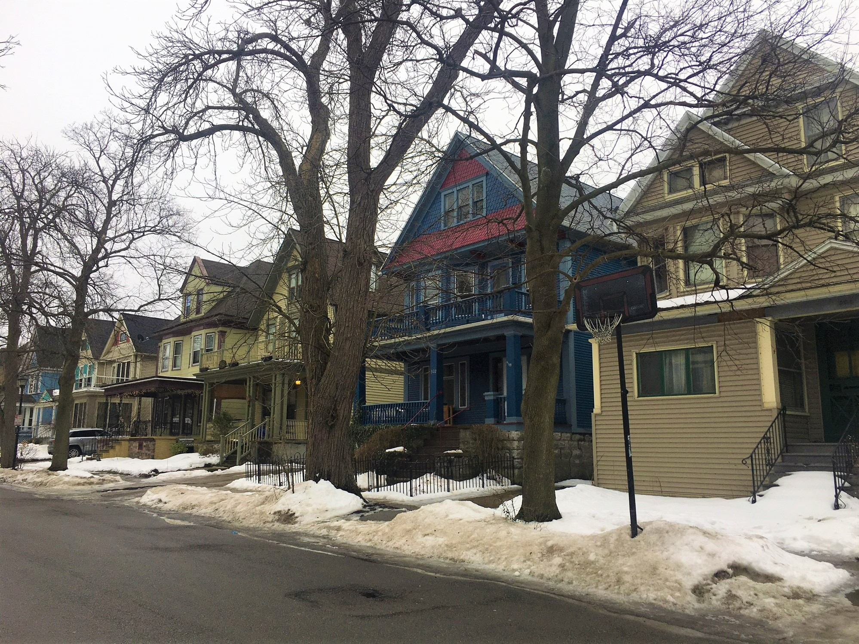
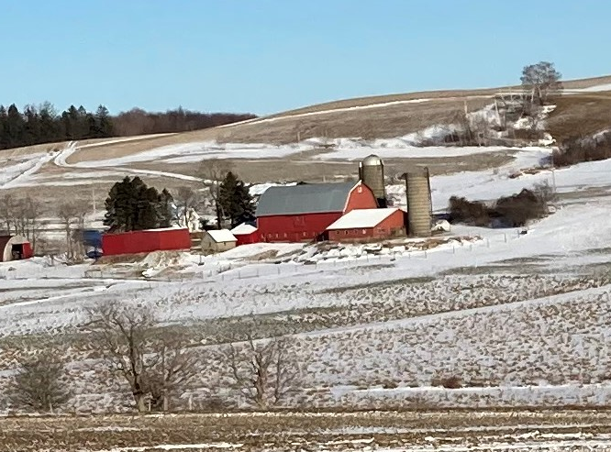
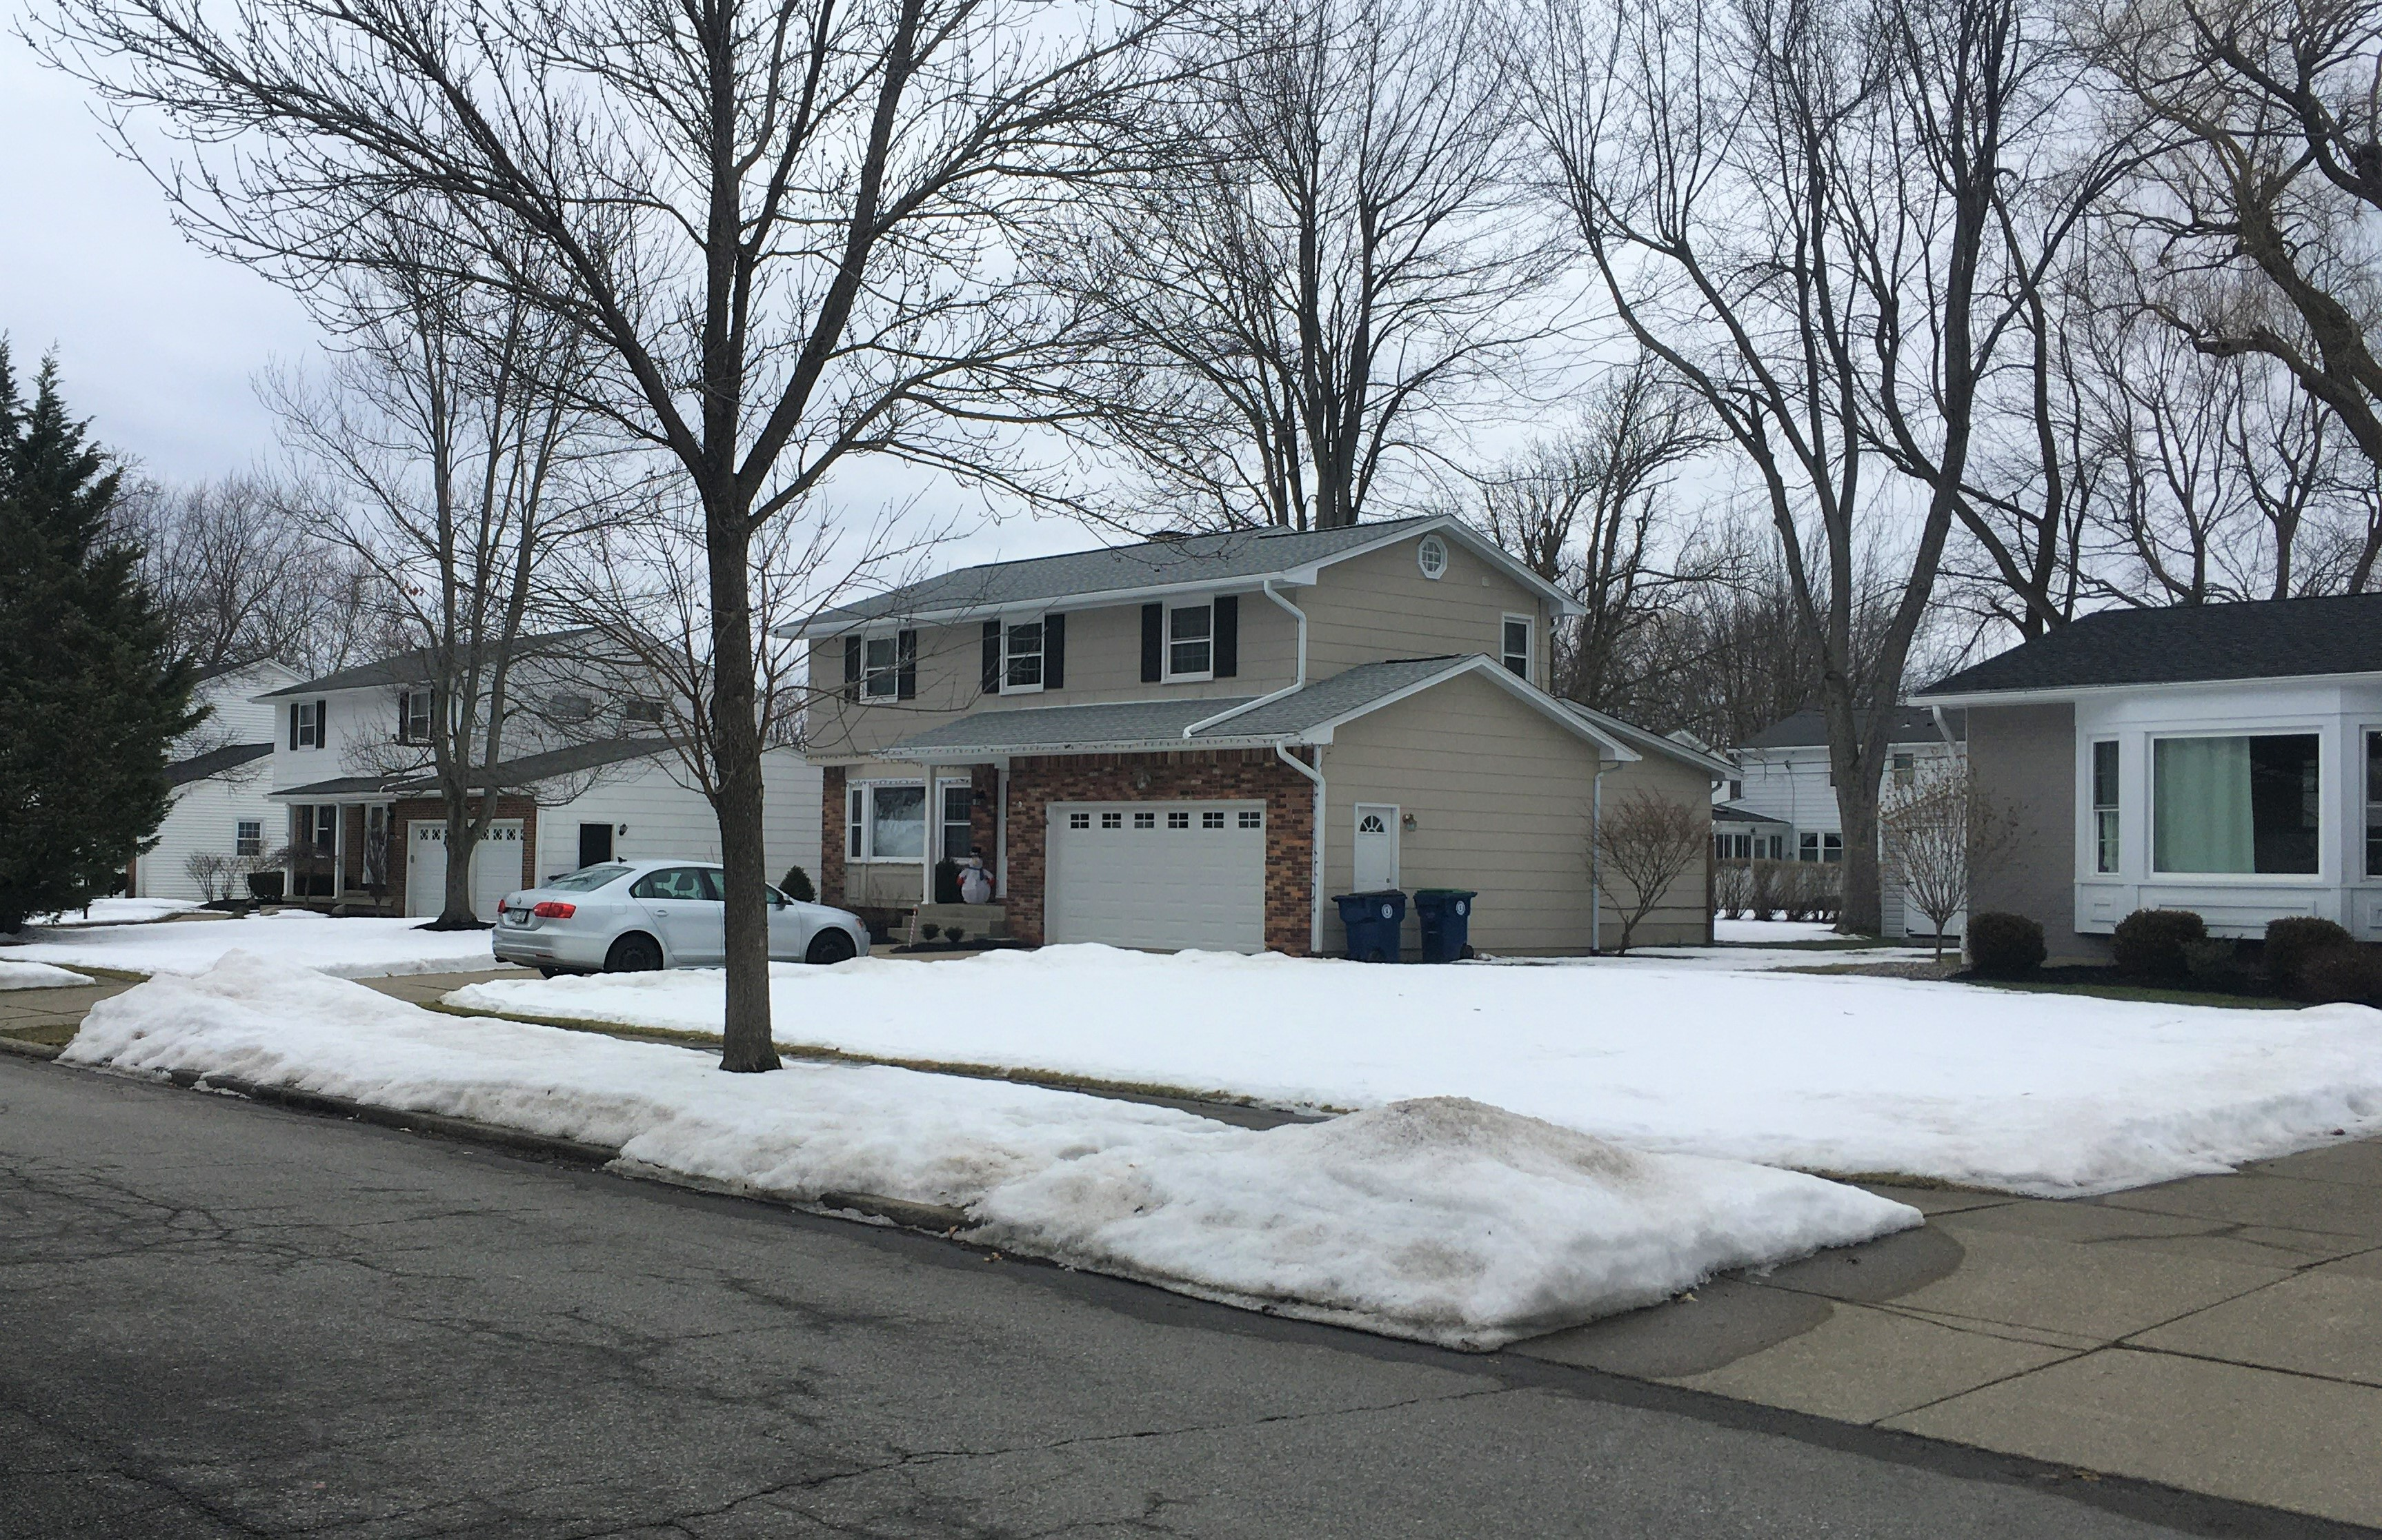
Guiding Community Character
Zoning: Drafting Regulations
Written Regulations
  Influence Character
    Lot size
    Density
    Setbacks
    Open space
    Height
    Orientation of
      Buildings
      Parking
    Noise and Light standards
Zoning

Slide 9

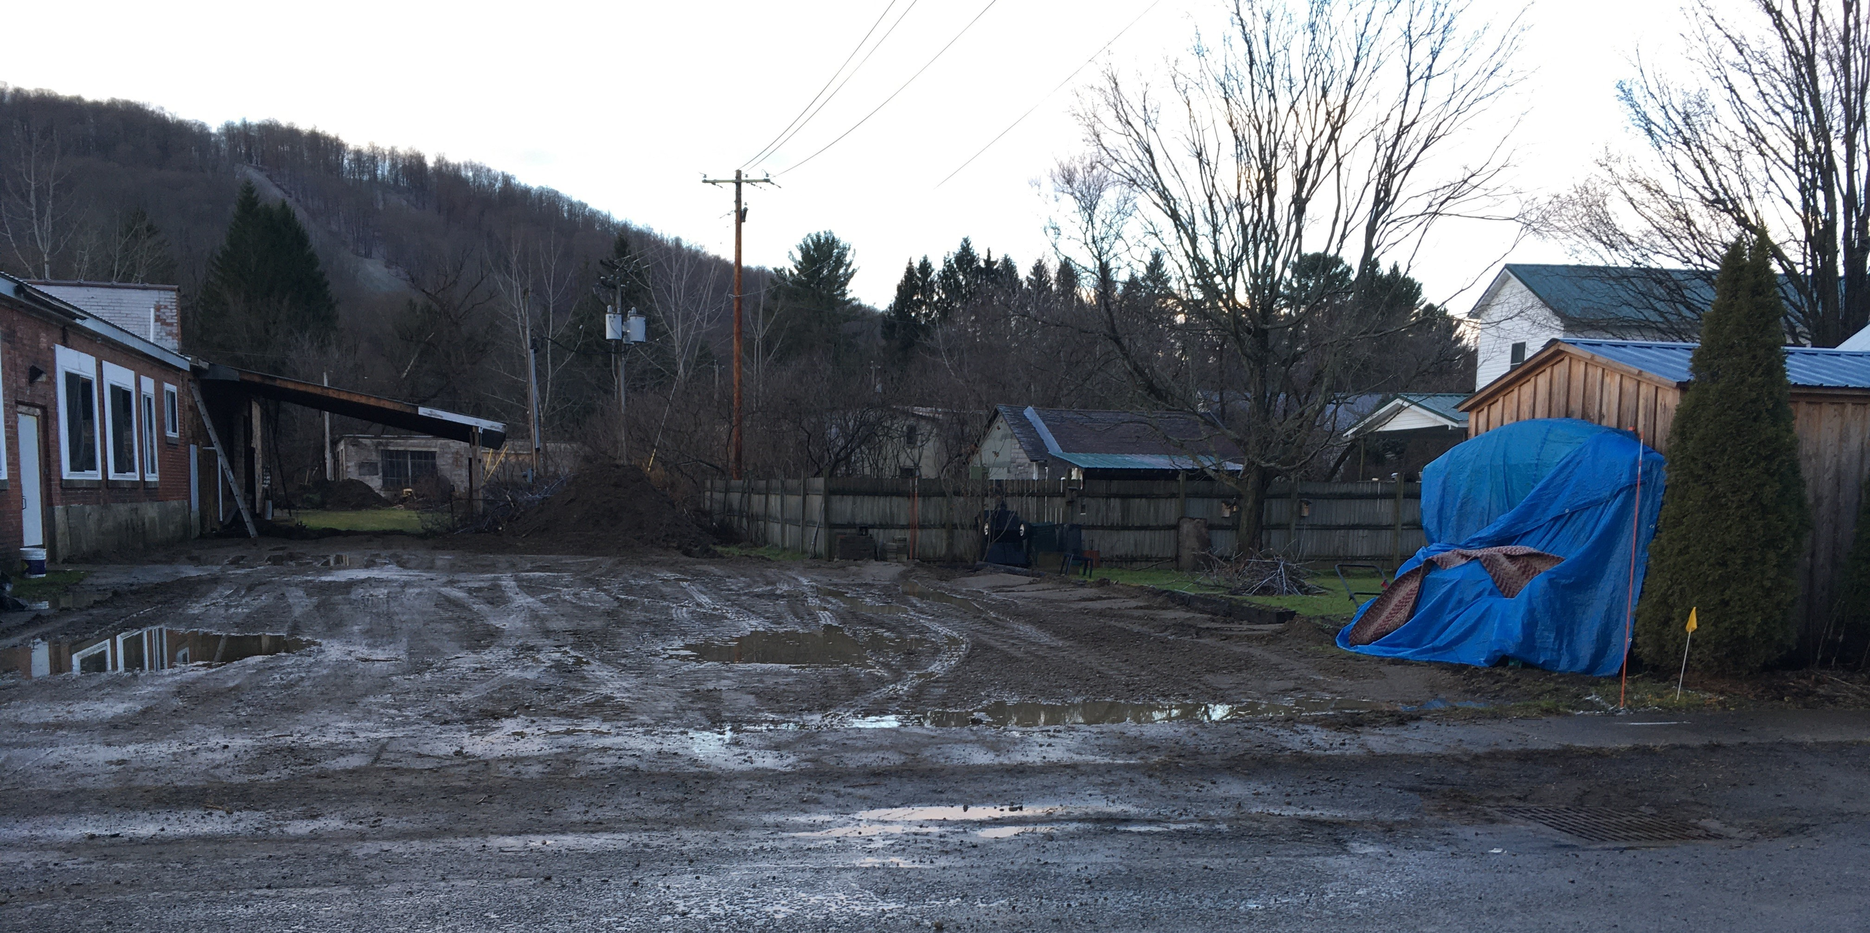
Zoning –
Implementation
Zoning and Building Permits - CEO
Special Use Permit – Allowed by P.B.
  Use-Specific and Site-Specific
Site Plan - Review by P.B.
  Lot orientation, building and parking location
  Landscape plan, outdoor lighting, signage
  Light and noise buffering to surrounding residential
  Elevation drawings required?
  Renderings required?

Slide 10
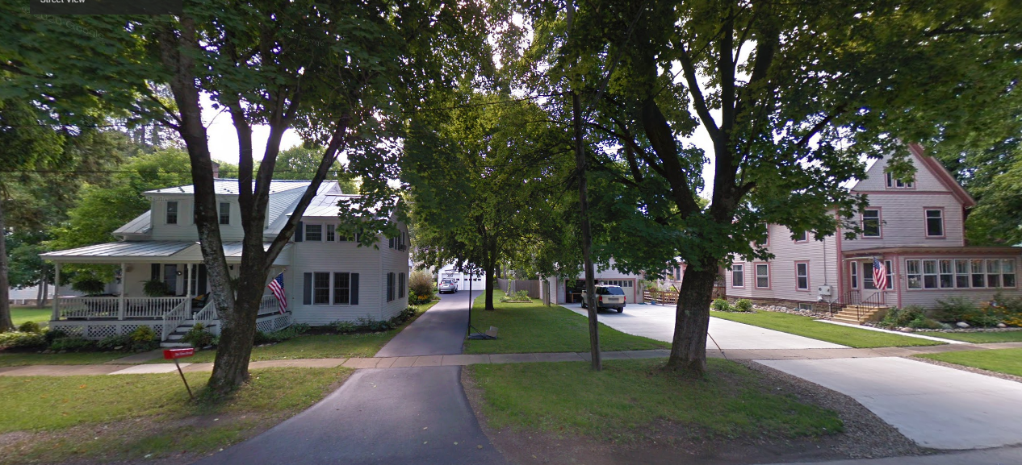
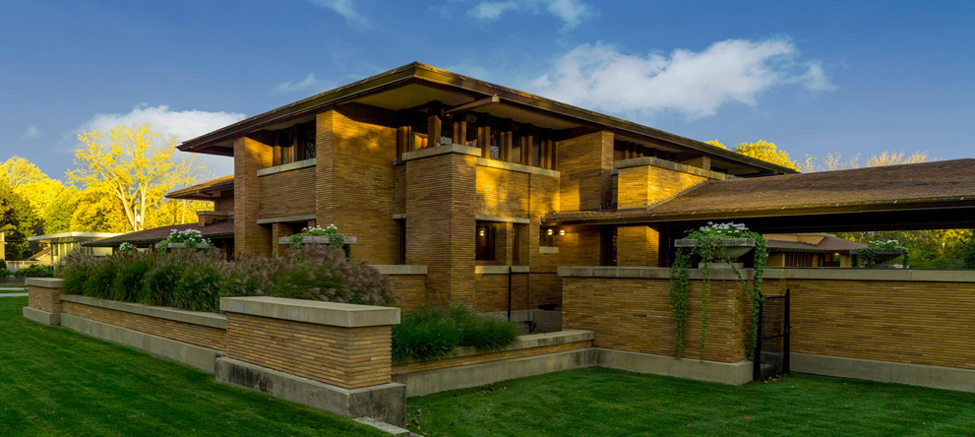
Zoning –
Implementation
Guidelines Must Be Objective and stated in Code
  Because Boards are Limited in Discretion
  Subject to Challenges for arbitrariness, and exceedance of lawful authority
Architectural Design Guidelines provide standards:
  General Style and Mass
  Exterior materials
  Roof pitches and materials
  Window and door styles
  Ornamentation
  Exterior Lighting

Slide 11
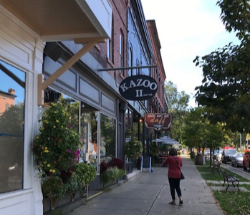
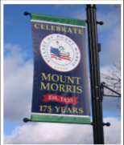
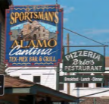
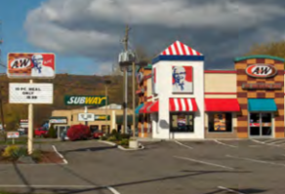
Zoning – Implementation
Signage as Community Character
  Don’t regulate the content of the sign
  Importance of Purpose, Intent, and Definitions
  Limit off-premise signs. Prohibit in residential.
  Number and square footage per location
  Signs on roofs? Painted on walls?
  Lighting: internal vs. overhead
  Removal after business has closed
  LED or electronic display signs

Slide 12
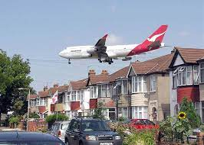
Why SEQRA is Important to Community Character
What is SEQRA?
  State Environmental Quality Review Act
  Statutory Mandates (ECL 8-109,) and Implementing Regulations (6 NYCRR 617)
SEQRA has a broad definition of the environment – physical conditions which will be affected by a proposed action, including land, air, water, minerals, flora, fauna, noise, objects of historic or aesthetic significance, existing patterns of population concentration, distribution, or growth, and existing community or neighborhood character.
Significant Adverse Impacts on Human or Natural Environment may
Impact Community Character
Impacts to the Human Environment are challenged due to:
  Noise
  Aesthetics
  Traffic

Slide 13
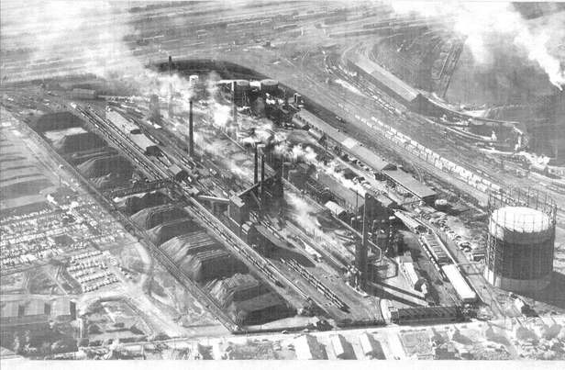
Enforcement to
Protect Community Character

Slide 14

Enforcement by Whom
Enforcement by the Building Inspector’s Office:
  by reviewing Permit Request, or
  by responding to Complaints
Enforcement through Planning and Zoning Board Actions
Enforcement by Impacted Persons through Article 78 Actions
Enforcement by Impacted Communities, beyond time limits of an Article 78 Action (Case Study) where government fails to Act

Slide 15
Determining Adverse Impacts on Community Character is Part of SEQRA Review Process and is Challengeable In Article 78 Action
This Wellsville NY SEQRA challenge case involved the challenge of the permitting of a big box store based upon community impacts.
With respect to the "community character" of the Village, we note that SEQRA defines "environment" as "the physical conditions which will be affected by a proposed action, including . . . existing community or neighborhood character" (ECL 8-0105 [6]), and "require[s] a lead agency to consider more than impacts upon the physical environment," including "the potential displacement of local residents and businesses" (Chinese Staff & Workers Assn. v City of New York, 68 NY2d 359, 366, 509 NYS2d 499, 502 NE2d 176 [1986]). Therefore, contrary to the Town Board's apparent conclusion, "[a] town . . . board reviewing a big box development should consider the impact of the development on the community character of a neighboring village that might suffer business displacement as a result of the approval of the big box development" SEQR Handbook at 179 [3d ed 2010… .
Matter of Wellsville Citizens for Responsible Dev., Inc. v. Wal-Mart Stores, Inc., 140 A.D.3d 1767, 1770, (2016)

Slide 16
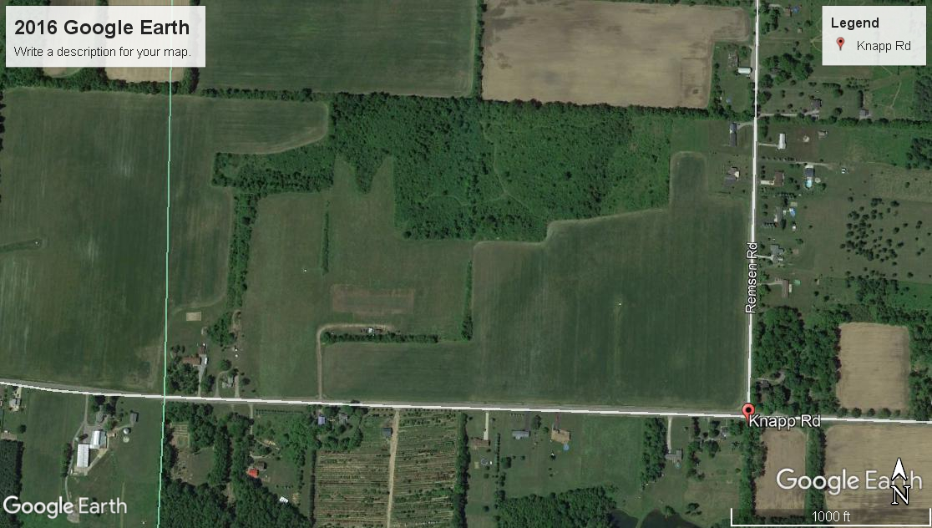
Agricultural-Residential Case Study of Model Plane Airport Permitted for Adult Enthusiasts;
Where Noise Impacts Community Character

Slide 17


Noise Pressures introduced by Siting Projects May be Found to objectively Impair Community Character.
NYSDEC has issued Guidance Doc for Assessing Noise Impacts on host communities. Summary Table is helpful

Slide 18
Key Facts to Knapp Road Case Study
Non-Agricultural of Residential Use not Permitted within Zone
Special Use Permit issued not authorized by Zoning Code grants no rights
Application of NYSDEC Guidelines may objectively establishes “Intolerable” Noise Conditions impairing Residential Use – changes character of the neighborhood (e.g. 26 Dba over background)
Interfered with ability to hear human voices in yards, and houses
Town does not Act on Citizen Complaint
Court, after trial, finds use unlawful, and Grants Injunctive Relief of Cease and Desist
When Board acts beyond powers and government does not stop unlawful use, after Petitioned, Citizen Groups may Petition Courts
Courts can, and sometimes do Order unlawful activities to cease and desist even after Projects built. Court shut down operations after Trial

Slide 19
Protecting against Adverse Impact of Community Character is Lawful and Required in Review Process
Lessons learned from experience:
Practical application of your zoning is what makes a difference in the “real world”- Follow and “Trust the Process” –it’s the law because many challenges may be based on failure to follow lawful process, and
EIS and Ultimate Denial may be based on adverse impact on character of – big box example where Commercial Big Box may displace sufficient number of small business to change character of community.
Establish realistic measurable review standards in Codes because Planning Boards, and ZBA’s are administrative Bodies
SEQRA – applies to adoption of Codes. And Application of Codes through discretionary approvals.
Agricultural districts, and Natural Environment may define your Community Character
Other ways to control/protect Community Character. The importance of listening and response in
a. Identifying Community Character in Comprehensive Plan,
b. Zoning Amendments, and
c. Permitting.

Slide 20
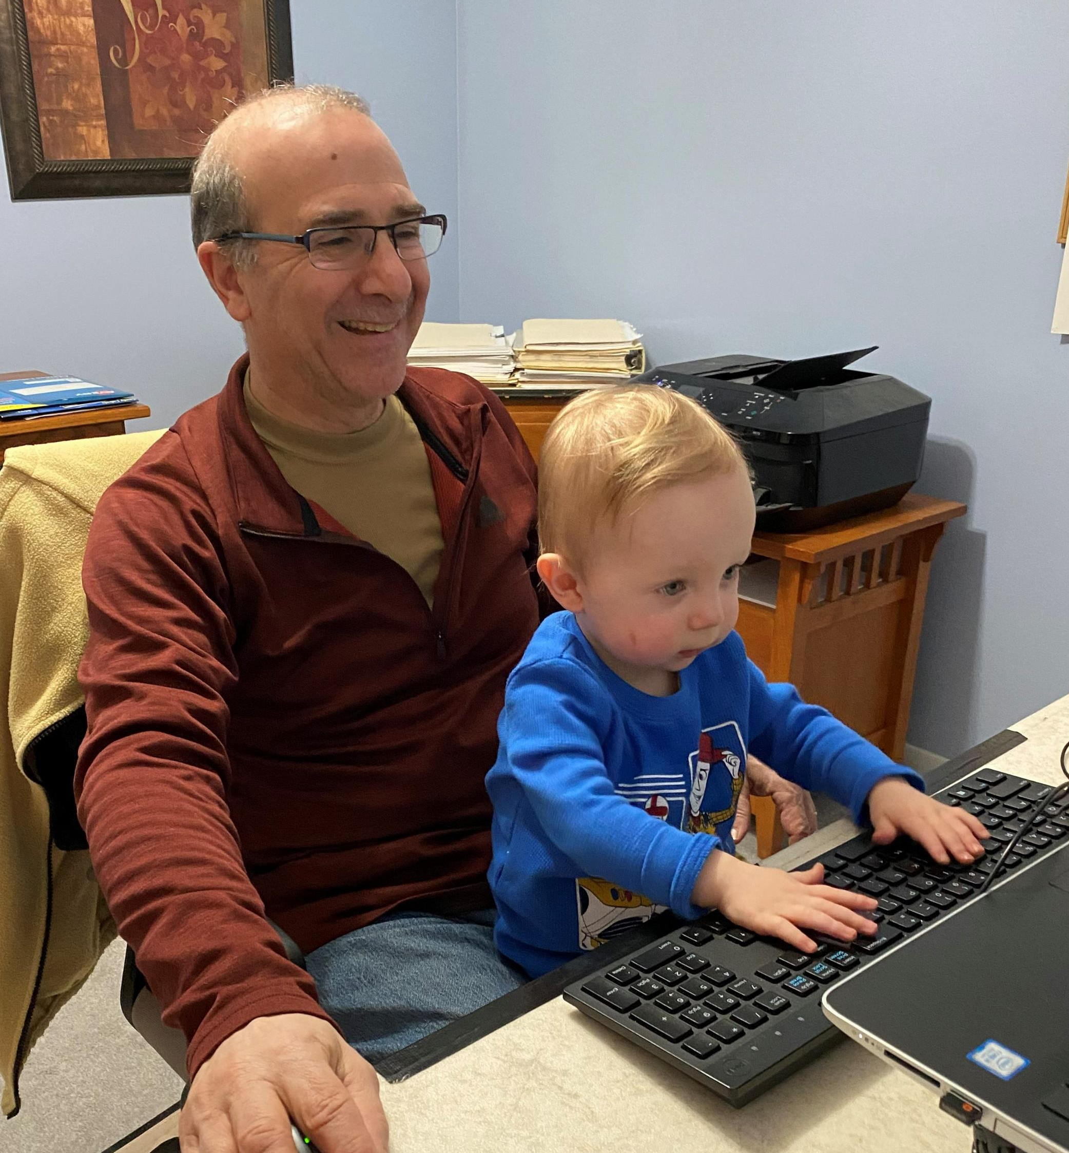
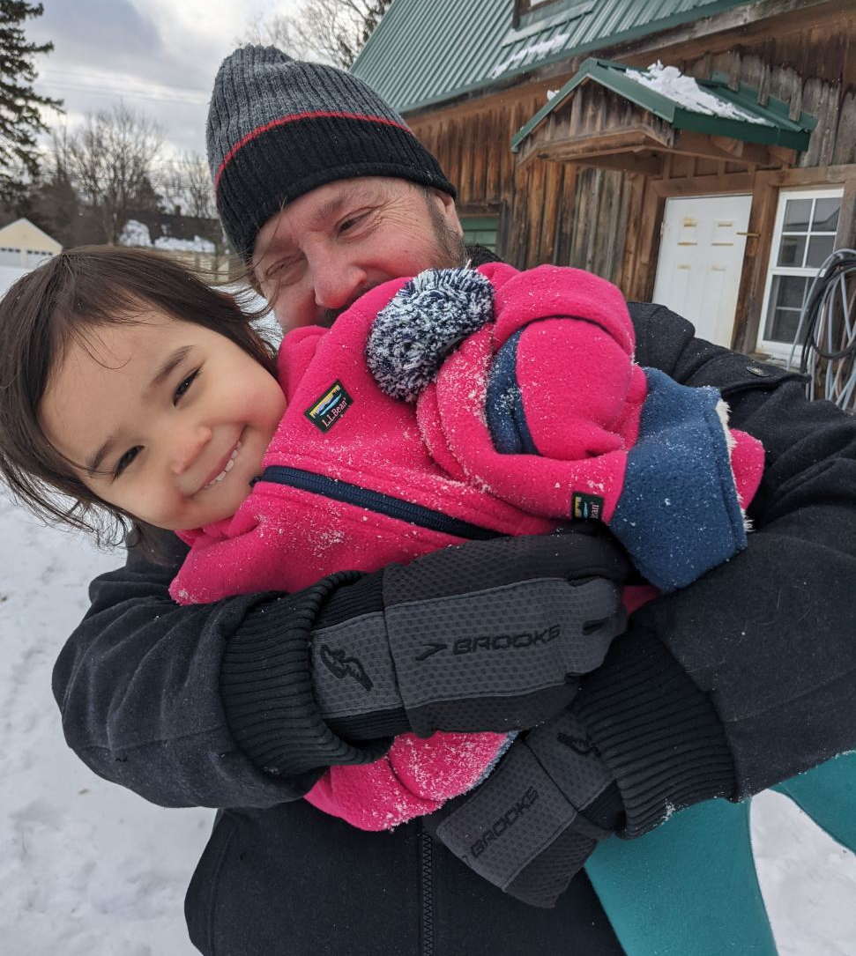
Q&A
Please send your questions through the Q&A button.
Thank you from our “team”
Gary Palumbo, AICP
gary.palumbo@evlengineering.com
716-801-3016
Richard Stanton, Esq.
richard.stanton@yahoo.com
716-827-6421

Slide 21
Additional Content Resources
New York State Division of Local Government Resources. (2009). Creating the community you want: Municipal options for land use control. James A. Coon Local Government Technical Series. https://www.dos.ny.gov/lg/a/Creating_the_Community_You_Want.pdf
New York State Division of Local Government Resources. (2015). Zoning and the comprehensive plan. James A. Coon Local Government Technical Series. https://www.dos.ny.gov/lg/publications/Zoning_and_the_Comprehensive_Plan.pdf
New York State Division of Local Government Resources. (2015). Municipal Control of Signs. James A. Coon Local Government Technical Series. https://www.dos.ny.gov/lg/publications/Municipal_Control_of_Signs.pdf

Slide 22
Image Sources
Slide 1: https://www.tourchautauqua.com/destinations/jamestown-renaissance-corporation
Slide 2: http://lackawannany.gov/wp-content/uploads/2021/01/SteveBalon_BuildingInspector_01222021-e1611333988936-400x243.jpg
Slide 3: https://www.smwllc.com/protect-meetings-zoom-teams-webex/
Slide 4: Photo credit Gary Palumbo (Bolton Landing, NY)
Slide 5: https://www.google.com/search?q=images+of+town+master+plan+process&tbm
Slide 6: https://www.uwsp.edu/cnr-ap/clue/Documents/Comprehensive_Planning/Land_Use_Resource_Guide_Chapter_7.pdf
Slide 7: Town of Ellicottville Zoning Map, amended September 17, 2014
Slide 8: Photo credit Gary Palumbo (housing density Amherst, NY – Buffalo, NY)
Slide 9: https://www.moyne.vic.gov.au/Your-Property/Building-and-Planning/Planning/Statutory-Planning/Planning-Permits
Slide 10: https://www.facebook.com/themartinhouse/
Slide 11: https://www.ellicottvillegov.com/planning--zoning.html; https://www.dos.ny.gov/lg/publications/Municipal_Control_of_Signs.pdf
Slide 17: https://www.dec.ny.gov/docs/permits_ej_operations_pdf/noise2000.pdf

